Slide 1
Interaction, Coordination & Negotiation
COMP 40040: Agent-Oriented Software
Lecturer: Rem Collier
Email: rem.collier@ucd.ie

Slide 2
KQML
Earlier you were introduced to Agent Communication Languages (ACLs) as enablers for agent interaction.
KQML: Knowledge Query and Manipulation Language (early 90’s)
Part of the Knowledge Sharing Effort (KSE), funded by ARPA
Developed to enable large scale sharable and reusable knowledge bases.
Initially conceived as an interface to a knowledge based system.
FIPA ACL: Foundation for Intelligent Physical Agents ACL (late 90s)
Part of the FIPA standardisation efforts.
Designed to overcome several well-known shortcomings of KQML
Concommitant standards for message transport services (HTTP, IIOP, ...), ontologies, agent platform, and agent management...

Slide 3
KQML Message Structure
KQML is an ‘outer’ language, that:
Defines the set of acceptable ‘communicative verbs’
Is syntactically independent of the inner content.
Provides the additional contextual information necessary for the receiver to understand the message.
e.g.
(ask-if
:sender agenti
:receiver agentj
:language Prolog
:ontology genealogy
:content
“spouse(adam, eve)”)
Communication
Mechanics of communication, e.g. Sender, receiver.
Performatives (message layer)
Logic of communication, e.g. ask, tell.
Content
Content of communication,
e.g. a KIF expression

Slide 4
KQML Performative Categories
Category | Performatives
Basic Query | evaluate, ask-if, ask-one, ask-all, ask-about
Multi-response Query | stream-about, stream-all
Response | reply, sorry
Generic informational | tell, achieve, cancel, untell
Generator | standby, ready, next, rest, discard, generator
Capability-definition | advertise, subscribe, monitor, import, export
Networking | register, unregister, forward, broadcast, route
Notes:
Examples of Performatives:
ask_-all: S wants all of R’s answers to a question.
Stream-all: multiple response version of ask-all
Reply: communicates an expected reply
Sorry: S cannot provide a more informative reply
Tell: S claims to R that C is in S’s virtual knowledge base
Ready: S is ready to respond to R’s previously mentioned performative
Subscribe: S wants updates to R’s response to a performative
Register: S can deliver performatives to some named agent

Slide 5
KQML Examples
(stream-about
:sender A :receiver B
:language Prolog :ontology motors
:reply-with q1 :content “item(m1)”)
(tell
:sender B :receiver A
:in-reply-to q1
:content “torque(m1, 12, kgf)”)
(tell
:sender B : receiver A
:in-reply-to q1
:content “status(m1, normal)”)
(eos
:sender B : receiver A
:in-reply-to q1)
(evaluate
:sender A : receiver B
:language Prolog :ontology motors
:reply-with q2
:content “value(torque, m1)”)
(reply
:sender B :receiver A
:language Prolog
:ontology motors
:in-reply-to q2
:content “torque(m1, 12, kgf)”)

Slide 6
KQML Facilitators
KQML environments (may) contain facilitators that help make the communication protocol transparent.
Facilitators: a special class of agents that perform useful communication services such as:
Maintain registry of service names
Forward messages to named services
Routing messages based on content
Provide matchmaking between information providers and seekers
Provide mediation and translation services
Notes:
Reference for Facilitators:
T. Finin, Y. Labrou, J. Mayfield. ”KQML as an Agent Communication Language”. In: J. Bradshaw (ed). Software Agents, AAAI Press/MIT Press, 1997, pp. 291-316.

Slide 7
KQML Facilitators
Point-to-point protocol
A is aware that it is appropriate
to send a query about X to B
There are several ways to achieve this via a Facilitator.
F
tell(X)
ask(X)
A
B
Notes:
F is the Facilitator and is not involved in the communication.

Slide 8
KQML Facilitators
Using the subscribe performative
Request that Facilitator F monitor for the truth of X. If B subsequently informs F that it believes X to be true, then F can in turn inform A.
subscribe(ask(X))
tell(X)
F
tell(X)
A
B
Notes:
F just forwards

Slide 9
KQML Facilitators
advertise(ask(X))
broker(ask(X))
Using the broker performative
A Asks Facilitator to find another agent which can process a given performative.
tell(X)
F
tell(X)
ask(X)
A
B
Notes:
A asks F to find an agent that can process an ask(x) performative. B independently informs F that it is willing to accept performatives matching ask(x). Once F receives both these messages, it send B the query, gets a response and forwards it to A.

Slide 10
KQML Facilitators
advertise(ask(X))
recruit(tell(X))
Using the recruit performative
Asks Facilitator to find an appropriate agent to which an embedded performative can be forwarded. A reply is returned directly to the original agent.
F
ask(X)
tell(X)
A
B
Notes:
Consider the situation where the performative from A is subscribe(x) rather than tell(x).

Slide 11
KQML Facilitators
recommend(ask(X))
advertise(ask(X))
Using the recommend performative
Asks Facilitator to respond with the ”name” of another agent which is appropriate for sending a particular performative.
F
reply(B)
ask(X)
A
B
tell(X)
Notes:
Service discovery.

Slide 12
KQML Criticism
Transportation mechanisms were not defined.
Set of performatives is large and ad hoc.
Lacked the class of performatives: commissives
Not possible to communicate commitment to an action
Difficult to implement multi-agent scenarios without commissives.
Weak semantics of performatives
Different implementations of KQML could not interoperate.

Slide 13
FIPA Agent Interaction

Slide 14
Who is (was) FIPA?
The Foundation for Intelligent Physical Agents (FIPA) is a non-profit association.
FIPA’s purpose is to promote the success of emerging agent-based applications, services and equipment.
FIPA operates through the open international collaboration of member organisations:
companies, universities and government organisations.
FIPAs Standards Cover:
Agent Communication (FIPA ACL / Interaction Protocols)
AO-Application Infrastructures (Agent Platform, Agent Management, Message Transport Systems)
Agent UML
Notes:
14
Companies: Alcatel, Boeing, British Telecom, Deutsche Telekom, France Telecom, Fujitsu, Hitatchi, HP, IBM, Fujitsu, Hewlett Packard, IBM, Intel, Lucent, NEC, NHK, NTT, Nortel, Siemens, SUN, Telia, Toshiba, etc.
Universities and Research Institutes: GMD, EPFL, Imperial, IRST, etc.
Government Agencies: DARPA

Slide 15
FIPA ACL: Introduction
FIPA is the official standards body for multi-agent systems
Its goal was (is) to standardise the concept of an agent and its underlying machinery.
Its goal was (is) to promote interoperability between technologies and systems.
FIPA membership includes many large multinationals (Alcatel-Lucent, Boeing, HP, IBM, Intel,…) and academic/government organisations and research institutes
The last standards released by FIPA in 2000 included:
Agent Communication
Application Infrastructures
Agent UML
FIPA Standards: http://www.fipa.org/repository/standardspecs.html

Slide 16
FIPA ACL Structure
Performative (communicative act)
20 performatives in FIPA ACL
Housekeeping
e.g. Sender, Reply to, Reply-with, In-Reply-With
Content
the actual content of the message
Language
The language in which the content is written
Ontology
The ontology in which the message needs to be interpreted.

Slide 17
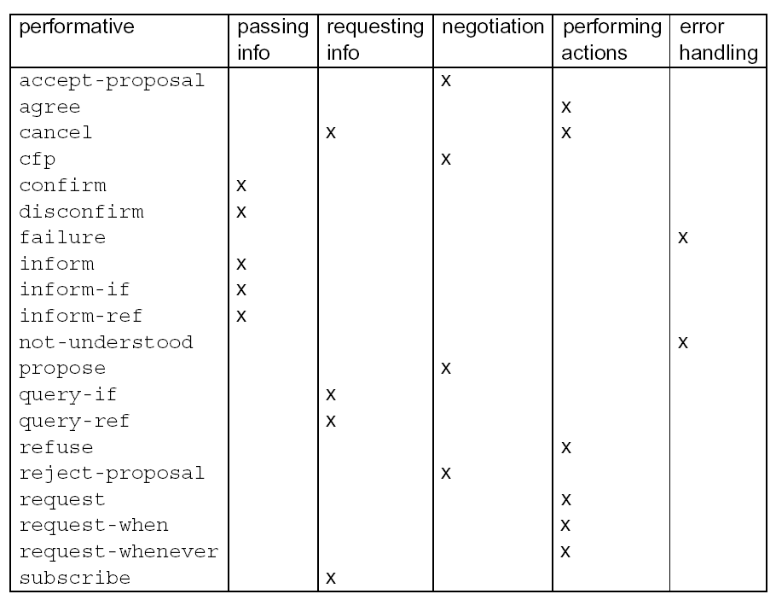
FIPA-ACL: Performatives

Slide 18
FIPA ACL: Message Structure
Transport-message: HTTP
Sender:
Transport-type: FIPA-HTTP
Transport-address: http://www.agentfactory.com:4444/
Transport-properties: none
Receiver:
Transport-type: FIPA-HTTP
Transport-address: http://www.ibeca.org:4444/
Transport-properties: none
Additional-attributes:
none
Envelope
Envelope:
Comprises of a collection of parameters
Contains at least the mandatory to and sender parameters
Message Body
The fully specified message in the chosen ACL syntax
Can be encoded (e.g. The FIPA Bit Efficient Encoding Mechanism).
Payload
(ACL message)
Notes:
18

Slide 19
FIPA ACL: Performative Semantics
 | Inform | Request
Content | statement | action
Precondition | Holds that the content is true. Intends that the recipient believe the content Does not already believe that the recipient is aware whether content is true or not | Intends action content to be performed Believes recipient is capable of performing this action Does not believe that sender already intends to perform action

Slide 20
FIPA ACL: Interaction Protocols
Ongoing conversations between agents fall into typical patterns.
In such cases, certain message sequences are expected, and at any point in the conversation, other messages are expected to follow.
In FIPA ACL, these patterns of message exchange are called protocols.
Each message can be annotated with a protocol identifier.
This provides valuable context for the receiver and helps it to
Understand how to respond to the message
(query-if :sender A
:receiver B
:content some-act
:protocol fipa-query-protocol
)

Slide 21
FIPA ACL: Interaction Protocols
Basic FIPA Interaction Protocols:
Propose Protocol
Query Protocol
Request Protocol
Cancel Meta-Protocol
Subscribe Protocol
More complex Protocols:
Recruiting Protocol
Brokering Protocol
Request When Protocol
English and Dutch Auctions, (Iterated) Contract Net (later)

Slide 22
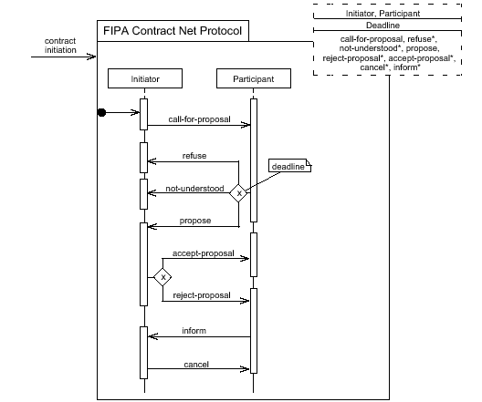
Insert: AUML Protocol Diagrams
Supports Parameterized Templates.
Messages constrained to communicative acts.
Optional AND, OR, XOR connectors for lifelines.
Multiple threads of interaction:
Concurrent: all together now
Decision: 0 or more
Selection: exactly 1

Slide 23
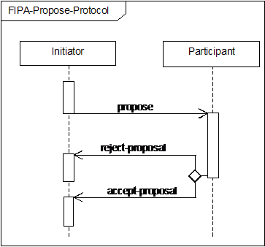
FIPA Propose Protocol
Initiator proposes that the participant perform some action.
The participant can:
Say no (reject-proposal)
Say yes (accept-proposal)
An accept-proposal message is typically followed by:
the execution of the agreed action
(if necessary) informing the initiator of the result of the action.

Slide 24
FIPA Propose Protocol
Robot BC45 asks robot XY29 to pick up box 432987.
(propose
:sender BC45
:receivers (set XY29)
:protocol fipa-propose
:language Prolog
:conversation-id 45
:content “pickup(432987)”)
(reject-proposal
:sender XY29
:receivers (set BC49)
:protocol fipa-propose
:language Prolog
:conversation-id 45
:content “pickup(432987)”)

Slide 25
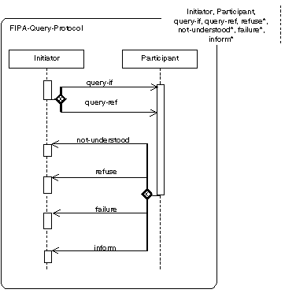
FIPA Query Protocol
The initiator send a query-if message to check the truth or falsity of some logical statement.
The Participant can respond in one of 4 ways:
Indicate it did not understand the query
Refuse to perform the query
Try (and fail) to perform the query
Inform the Initiator of the result of the query

Slide 26
FIPA Query Protocol
A robot checks whether there is beer in the fridge
(query-if
:sender robot
:receivers (set fridge)
:protocol fipa-query
:language Prolog
:content “have(beer)”)
(inform
:sender fridge
:receivers (set robot)
:protocol fipa-query
:language Prolog
:content “~have(beer)”)

Slide 27
FIPA Query Protocol
The initiator send a query-ref message to retrieve state information from another agent.
The Participant can respond in one of 4 ways:
Indicate it did not understand the query
Refuse to perform the query
Try (and fail) to perform the query
Inform the Initiator of the result of the query

Slide 28
FIPA Query Protocol
A robot checks how much beer is in the fridge
(query-ref
:sender robot
:receivers (set fridge)
:protocol fipa-query
:language Prolog
:content “quantity(beer, X)”)
(inform
:sender fridge
:receivers (set robot)
:protocol fipa-query
:language Prolog
:content “quantity(beer, 5)”)

Slide 29
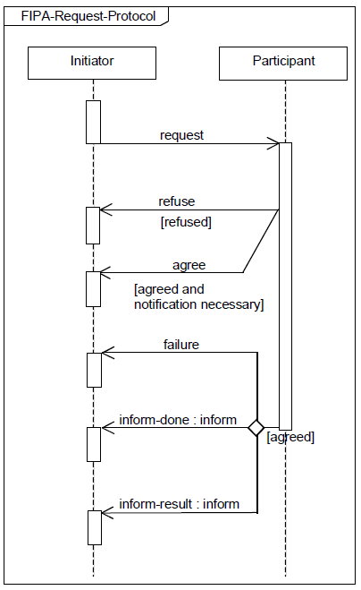
FIPA Request Protocol
Initiator requests that some task be performed
Participant either agrees to or refuses the request
Participant performs the task and tells the initiator:
Of the failure of the task
That the task is done
The result of the task

Slide 30
FIPA ACL: Example Messages
Rem asks the robot for a beer:
(request
:sender rem
:receivers (set robot)
:language ASTRA
:content “get(beer)”
)
(refuse
:sender robot
:receivers (set rem)
:language ASTRA
:content “get(beer)”
)
(request
:sender rem
:receivers (set robot)
:language ASTRA
:content “get(beer)”
)
(agree
:sender robot
:receivers (set rem)
:language ASTRA
:content “get(beer)”
)
(inform
:sender robot
:receivers (set rem)
:language ASTRA
:content “have(beer)”
)

Slide 31
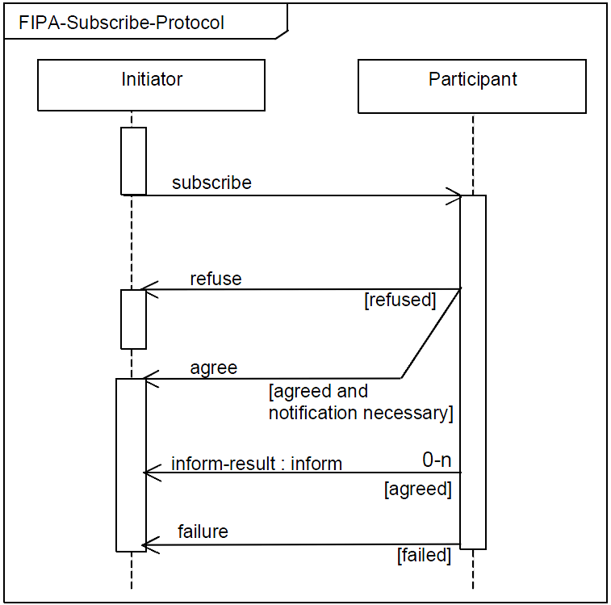
Example: FIPA Subscribe Protocol
Initiator subscribes to the participant.
Participant either agrees or refuses subscription
Participant informs initiator of any information relating to the subscription or sends a failure message if necessary.

Slide 32
FIPA Subscribe Protocol
A book_launcher agent offers a subscription service for information about new books:
(subscribe
:sender bob :receivers (set book_launcher)
:protocol fipa-subscribe
:language ASTRA
:content “new_books([\”fantasy\”,\”cooking\”])”)
(agree
:sender book_launcher :receivers (set bob)
:protocol fipa-subscribe
:language ASTRA
:content “new_books([\”fantasy\”,\”cooking\”])”)
(inform
:sender book_launcher :receivers (set bob)
:protocol fipa-subscribe
:language ASTRA
:content “book(\”fantasy\”,
\”Harry Potter and the Philosophers Stone\”,
\”J.K.Rowling\”)”)

Slide 33
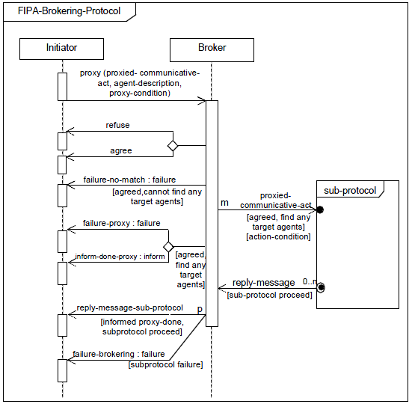
Example: FIPA Brokering Protocol

Slide 34
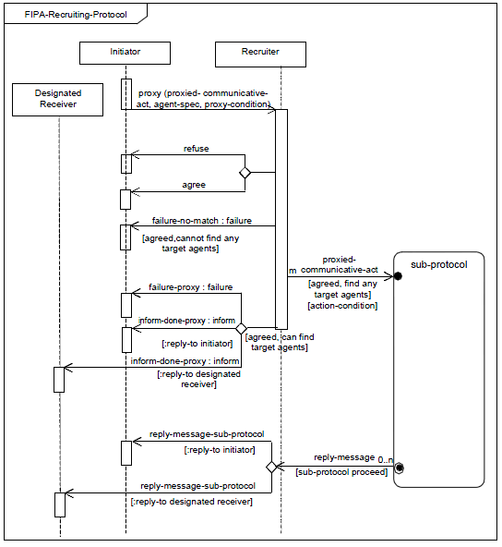
Example: FIPA Recruit Protocol

Slide 35
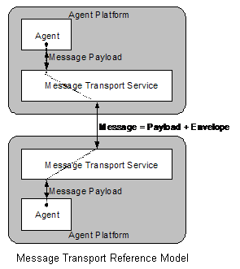
FIPA Transport management

Slide 36
Comparing KQML and FIPA
Similarities:
Separation of the outer language (performative) and the inner language (content).
Allows for any content language
Differences:
Communication primitives:
KQML – performative
FIPA ACL – communicative act
Different semantic frameworks – impossible to come up with an exact mapping or transformation between KQML and FIPA performatives.
KQML provides facilitator services; FIPA ACL provides protocols.

Slide 37
FIPA ACL & ASTRA

Slide 38
FIPA ACL & ASTRA
ASTRA uses FIPA ACL for its message format
It does not attempt to adhere to the FIPA infrastructure standards
Nor does it attempt to comply with the underlying formal model for the ACL
ASTRA supports communication through:
Message Events:
@message(<performative>, <sender>, <content>)
The Send Plan Operator:
send(<performative>, <receiver>, <content>)
Agents are written using standard ASTRA code + these extra bits…

Slide 39
Example: FIPA Request Protocol
agent BeerParticipant {
rule @message(request, string sender, get(X)) {
if (~has(X)) send(refuse, sender, get(X));
else {
send(agree, sender, get(X));
try {
!get(X);
!deliver(X, sender);
send(inform, sender, got(X));
} recover {
send(failure, sender, get(X));
}
}
}
}

Slide 40
Example: FIPA Request Protocol
agent BeerInitiator {
module Console C;
rule +!main(list args) {
send(request, “participant”, get(“beer”));
}
rule @message(agree, string sender, get(“beer”)) {
wait(got(“beer”) | failed_to_get(“beer”));
if (got(“beer”)) C.println(“Yummy in my tummy!”);
}
rule @message(inform, string sender, got(“beer”)) {
+got(“beer”);
}
rule @message(failure, string sender, get(“beer”)) {
+failed_to_get(“beer”);
}
}

Slide 41
Coordinating Agents

Slide 42
Coordination
”The process by which an agent reasons about its local actions and the (anticipated) actions of others to try and ensure that the community acts in a coherent manner.”
Nick Jennings,1996

Slide 43
Why Coordinate?
Preventing anarchy or chaos
Dependencies between agents’ actions.
Need to meet global constraints
No individual has sufficient competence, resources or information to solve the entire problem.
Efficiency

Slide 44
Cooperative Problem Solving
1.
Problem
decomposition
2.
Subproblem
solution
3.
Answer
synthesis

Slide 45
Cooperative Problem Solving
How to break a problem down into a set of atomic sub-problems:
Identify a minimal set of atomic operations that can be performed by individual agents.
Repeatedly decompose the initial problem.
Issues:
What is an appropriate level of granularity?
How to decompose the problem?
Who should decompose the problem?
Who should solve the sub problems?
1.
Problem
decomposition

Slide 46
Cooperative Problem Solving
Solving individual sub-problems.
Sub-problems are allocated in the previous phase.
Sub-problems may have dependencies.
Agents assigned sub-problems may need to share information.
Issues:
How to get help?
Who to share information with?
What information to share?
2.
Subproblem
solution

Slide 47
Cooperative Problem Solving
Combining the results
Solutions to atomic sub-problems are combined to provide solutions to higher-level sub-problems.
Partial solutions may be assembled during this process.
Issues:
Who does the solution synthesis?
How are the sub-problems combined?
Where are the sub-problems combined?
3.
Answer
synthesis

Slide 48
How to Coordinate?
There are two common forms of coordination:
Task sharing:
When a problem is decomposed into subproblems and allocated to different agents.
Result sharing:
When agents share information relevant to their subproblems.
Task 1
Task 1.1
Task 1.2
Task 1.3
A1
A2
A3

Slide 49
Task Sharing
The agent decomposes the task into a set of sub-tasks that are assigned to agents:
The tasks are assigned dynamically at run-time based on agents capabilities.
The task allocation process can be done:
through a central coordinator (manager) that is authorised to assign tasks to worker agents.
through some form of coordination mechanism that allows peers to reach agreement as to who will do what (e.g. negotiation).
Task 1
Task 1.1
Task 1.2
Task 1.3

Slide 50
Result Sharing
Problem solving proceeds by agents cooperatively exchanging information as the solution is developed.
The set of tasks are pre-assigned at design time
Results may be shared:
proactively - one agent sends another agent some information because it believes that the other will be interested in it.
reactively – an agent sends information to another in response to a request.
A1
A2
A3
Notes:
Result sharing is used in blackboard systems.

Slide 51
Result Sharing
A Result Sharing system’s performance takes advantage of:
Confidence: Higher confidence in a result if multiple agents independently derive it.
Completeness: Sharing local views can help to achieve a better global view.
Precision: Individual agents are able to refine their result based upon the results of the other agents.
Timeliness: If the agents work together to formulate the solution in parallel, the result can be attained quicker.

Slide 52
Question
Traffic Management:
I have a community of agents that are monitoring the level of traffic on a road network.
Individual agents are responsible for pre-defined area of the road network.
When an agent detects a build up of traffic in its area, it contacts a pre-assigned traffic management agent.
Mobile Computing:
A personal agent (located on a users PDA) requests a map centred around the users coordinates that shows nearby hotels.
The map request is sent to a pre-assigned map-broker agent who then contacts an appropriate “map agent” to get the basic map and an appropriate “restaurant agent” to get a list of nearby restaurants and their coordinates.
Are these examples of coordination? If so, what type?

Slide 53
The Contract Net Protocol

Slide 54
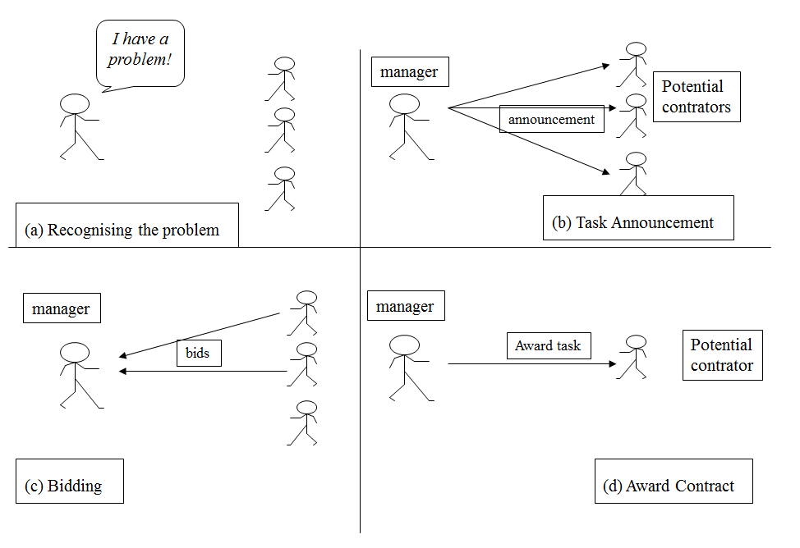
The Contract Net Protocol
A well known protocol for task sharing is the Contract Net Protocol.
It is commonly broken down into 5 key stages:
Recognition
Announcement
Bidding
Awarding
Expediting

Slide 55
Recognition
In this stage, an agent recognizes it has a problem it wants help with.
An agent has a goal, and either…
realizes it cannot achieve the goal in isolation — does not have the capability
realizes it would prefer not to achieve the goal in isolation (typically because of solution quality, deadline, use of resources, etc.)
I have a problem!
(a) Recognising the problem

Slide 56
Announcement
In this stage, the agent with the task sends out an announcement of the task which includes a specification of the task to be achieved
Specification must encode:
Description of the task itself
Any constraints (e.g. deadlines, quality constraints)
Meta-task information (e.g. preference on attributes)
The announcement is then broadcast
manager
Potential
contrators
announcement
(b) Task Announcement

Slide 57
Bidding
Agents that receive the announcement decide for themselves whether they wish to bid for the task
Factors:
agent must decide whether it is capable of expediting task
agent must evaluate the cost of making the task and the benefits it can get from making it
If an agent chooses to bid, then it submits a tender, detailing the conditions on which it can execute the task
manager
bids
(c) Bidding

Slide 58
Awarding & Expediting
The agent that sent the task announcement must choose between bids & decide who to “award the contract” to
The result of this process is communicated to the agents that submitted a bid
The successful contractor then expedites the task.
That may involve generating further manager-contractor relationships: sub-contracting
manager
Award task
Potential
contrator
(d) Award Contract

Slide 59
The Contract Net
The collection of nodes (agents) is the “contract net”
Each node on the network can, at different times or for different tasks, be a manager or a contractor
When a node gets a composite task (or for any reason can’t solve its present task), it breaks it into subtasks (if possible) and announces them (acting as a manager), receives bids from potential contractors, and then awards the job.

Slide 60
Implementation Issues
How to…
… specify tasks?
… specify quality of service?
… select between competing offers?
… differentiate between offers based on multiple criteria?

Slide 61
Optimisations
Focused addressing: when general broadcast isn’t required
Agents could automatically learn which are the most appropriate nodes for common tasks
Directed contracts: when manager already knows which node is appropriate
For instance when a very similar task has already been done in the past
Proactive Offers: when a node thinks a manager might need a task performed
The nodes can make proactive offers to potential managers of the kind of tasks they are able to execute

Slide 62
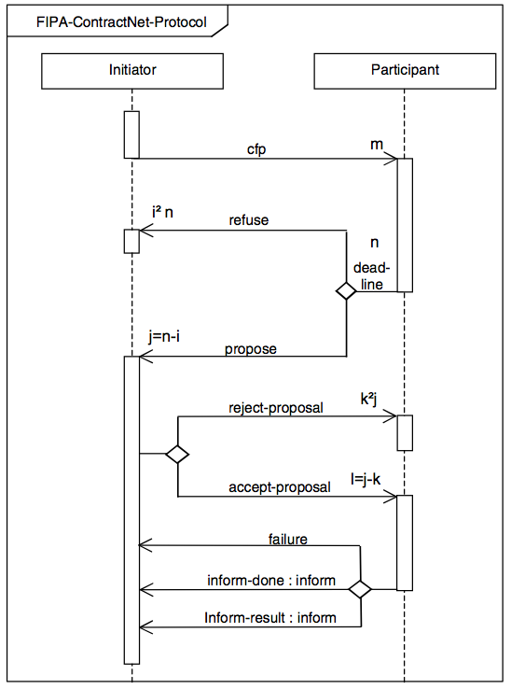
The Contract Net Protocol

Slide 63
Handling Inconsistency
Inconsistencies occur in cooperative systems.
Agents do not share common objectives.
No single agent has a global view of the system.
Cooperating agents may have incompatible belief sets.
Sensory apparatus may be faulty or return erroneous data.
Potential Solutions:
Don’t let it happen (or ignore it): In Contract Net based systems, it is the managers view of the problem that matters.
Resolve inconsistencies through bargaining: Agents try to overcome the inconsistency by discussing the problem – in practice, this leads to message explosion.
Building systems that degrade gracefully in the presence of inconsistency: Design systems that are aware of inconsistencies and attempt to handle them.

Slide 64
Functionally Accurate / Cooperative Systems
Nodes cooperatively exchange and integration partial, tentative high-level results to construct a consistent and complete solution.
Problem solving is not constrained to a particular sequence of events - it progresses opportunistically and incrementally.
Agents exchange high-level intermediate results rather than by exchanging raw data.
Uncertainty and inconsistency is resolved when partial results are exchanged and compared with other partial solutions.
The solution is not constrained to a single solution route – any potential solution is accepted.

Slide 65
Coordination Example
Consider an interaction between two robots, A and B, operating in a warehouse.
Each robot has been designed a different manufacturer.
They both have the capability to stack and unstack boxes that contain goods that have been stored in the building.
Because both robots work concurrently, they need to coordinate their actions to share the work load and to avoid knocking into each other and dropping the boxes.

Slide 66
Coordination Example
Task Sharing:
Our warehouse agents agree a distribution of work and then go about that work.
Robot A works on the east side of the building.
Robot B works on the west side.
Result Sharing:
Agents keep each other informed of their current activities and decide what to do independently.
Robot A decides to move box number A10456.
Robot A tells Robot B.
Using this additional information, Robot B independently decides to move another box A20987.

Slide 67
Astra And The Contract Net

Slide 68
The Initiator
First “cfp” message is sent to all participants in the protocol.
We will model the list of participants as beliefs of the form:
participant(string X)
Further, we can see that the protocol allows the participants to refuse to participate.
We will model refusal to participate as beliefs of the form:
refused(string X)

Slide 69
The Initiator
agent Initiator {
module Console C;
module System S;
rule +!send_cfp(string product, int quantity) {
foreach (participant(string X)) {
send(cfp, X, purchase(product, quantity));
}
}
rule @message(refuse, string X, purchase(string product, int quantity)) : participant(X) {
+refused(X);
!check_if_completed(product, quantity);
}
rule @message(propose, string X, purchase(string product, int quantity, int price)) :
participant(X) & ~refused(X) {
+responded(X, price);
!check_if_completed(product, quantity);
}
rule @message(inform, string X, order_sent(string product, int quantity)) {
// ...
}

Slide 70
The Initiator
rule +!check_if_completed(string product, int quantity) {
synchronized (check) {
+state("finished");
int best_price = 10000000;
string winner = "";
foreach(participant(string Y)) {
if (~refused(Y) & ~responded(Y, int p)) -state("finished");
if (responded(Y, int p) & p < best_price) {
best_price = p;
winner = Y;
}
}
if (state("finished")) {
send(accept-proposal, winner, purchase(product, quantity));
foreach(participant(string Y)) {
if (responded(Y, int p) & Y ~= winner) {
send(reject-proposal, Y, purchase(product, quantity));
}
if (refused(Y)) -refused(Y);
if (responded(Y, int p)) -responded(Y, p);
}
}
}
}
}

Slide 71
The Participant
This agent receives a cfp and determines how to respond.
Refusal = not bidding
Proposal = a bid
For the purposes of this example, we will use random numbers to determine:
Whether to refuse or propose a bid
The actual bid price

Slide 72
The Participant
agent Participant {
module Console C;
module System S;
module Math M;
rule @message(cfp, string X, purchase(string product, int quantity)) {
if (M.randomInt() % 100 < 40) {
send(refuse, X, purchase(product, quantity));
} else {
send(propose, X, purchase(product, quantity, 5+M.randomInt()%20));
}
}
rule @message(accept-proposal, string X, purchase(string product, int quantity)) {
C.println("[" + S.name() + "] sending product: " + product);
send(inform, X, order_sent(product, quantity));
}
rule @message(reject-proposal, string X, purchase(string product, int quantity)) {
C.println("[" + S.name() + "] rejected: " + product);
}
}

Slide 73
Running an Example
Add the following to Initiator.astra:
// Example code that creates 2 participants and uses contract net to tender for apples...
initial participant("fred"), participant("joe");
rule +!main(list args) {
foreach(participant(string X)) {
S.createAgent(X, "Participant");
}
!send_cfp("apples", 50);
}

Slide 74
Alternatives to the Contract Net…
Or how I sold my mothers shoes

Slide 75
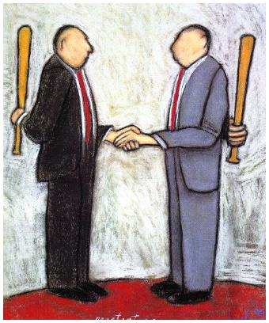
Negotiation
”The process of several agents searching for an agreement” e.g. about price.
Reaching consensus
”Rules of Encouter” by
Rosenchein and Zlotskin, 1994

Slide 76
Auctions
An Auction takes place between an auctioneer and a collection of bidders.
Goal is for the auctioneer to allocate the goods to one of the bidders.
In most settings, the auctioneer desires to maximise the price; bidders desire to minimise the price.
Price
bidder
auctioneer
bidders
auctioneer

Slide 77
Auction Parameters
Value of goods | Private, public/common, Correlated
Winner determination | First price, second price
Bids may be | Open cry, Sealed
Bidding may be | One shot, ascending, descending

Slide 78
English Auctions
English auctions are:
First price
Open cry
Ascending
Dominant strategy: successively bid a small amount more than the highest current bid until it reaches the valuation, then withdraw.
Susceptible to Winners curse
Winner is the one who overvalues the goods on offer and may end up paying more than its worth.
Price
Bidder x
Bidder 1
auctioneer
Notes:
Susceptible to shills: lying by the auctioneer to put bogus bids to artificially raise the current bidding price.

Slide 79
English Auctions
Auctioneer proposes an initial value for the item (the reserve price)
Bidders respond by submitting bids for the item.
The auctioneer selects the best bid and announces it to the bidders (including the agent whose bid has been accepted).
Bidders respond with improved bids or withdraw.
The auction terminates when no improved bid is received and last accepted bid wins.

Slide 80
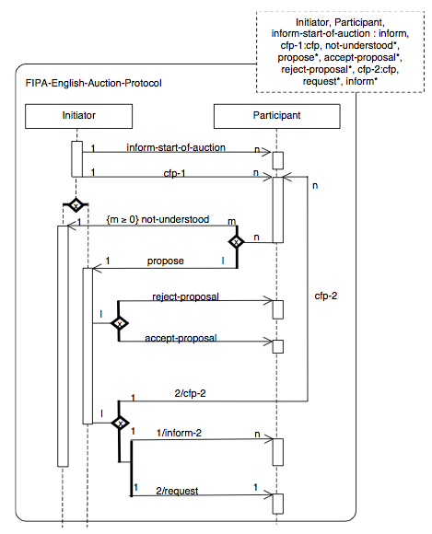
English Auctions

Slide 81
Dutch Auctions
Dutch auctions are:
Open cry
Descending
Auctioneer starts at an artificially high price.
Then continually lowers the offer price until an agent makes a bid which is equal to the current offer price.
Dominant strategy: None
Susceptible to Winners curse
Price
auctioneer
auctioneer
Bidder

Slide 82
Dutch Auctions
The auctioneer starts with an artificially high price.
Bidders decide whether or not to agree to the valuation.
The any bidder that agrees with the valuation proposes to accept the item for that price.
The auctioneer identifies who responded first and awards the item to that bidder.

Slide 83
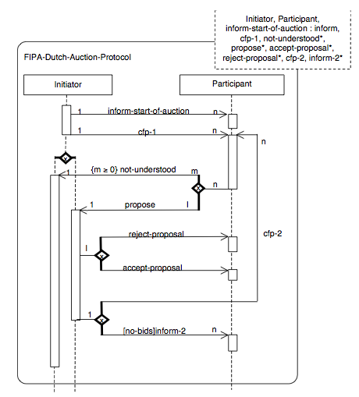
Dutch Auctions

Slide 84
First-price Sealed-bid Auctions
One shot auction
Single round, where bidders submit a sealed-bid for the good.
Good is awarded to agent that made the highest bid.
Winner pays price of highest bid.
Best strategy: bid less than true value.
Bidders
auctioneer

Slide 85
Vickrey Auctions
Vickrey auctions are:
second-price
sealed-bids
Goods are awarded to agent that made the highest bid.
Winner pays price of second highest bid.
Best strategy: bid the true value.
Susceptible to anti-social behaviour
Notes:
.

